Slide 1
Contract Analytics POC
September 2020

Slide 2
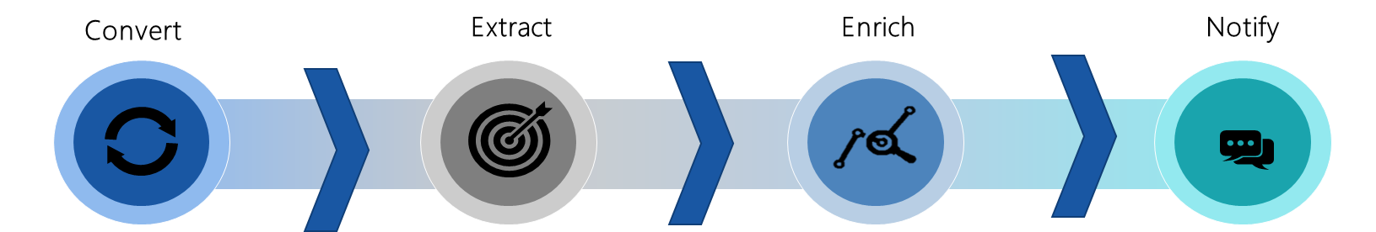
Objective & Scope
Contracts Management Process Flow
Digitization: Paper-Based contracts are digitized by OCR conversion
Entity Extraction: Firms, Spend, Milestones, Timelines, Tasks, Activities, are extracted & mapped using ML Models
Intelligence: Enrich supplier data with external data to build supplier profiles & recommendation engines
Notification: End-users are notified prior to a delivery timeline (or) to plan for timeline extensions & overshooting budget
Scope of Work Undertaken
Contract to Text Module
Entity Detection Module for specific segments
Contract Segmentation Module
Segment Topic Models (Supervised)
Entity Extraction
Input Contract (PDF / Word Document)

Slide 3

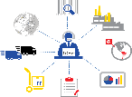
Sample Business Applications
Budgetary Planning – Performance measurement & budgetary planning
Spend Analytics – Better utilization of spends under contracts
Scenario Planning – Assess impact on demand & supply drivers for budgetary planning using hypothesis testing tools
Procurement Optimization – Forecasting to optimize procurement
Contracts Management – NLP to Digitize, structure & manage contracts, clauses & engagement
Vendor Evaluation – Using external / big data intelligence to evaluate companies / vendors
Impact Assessment – Measure program incrementalities & RoI from initiatives
Quality Control – Proactive measurement of procurement effectiveness & supplier performance
Spend Intelligence
Supplier Management

Slide 4








Solution Outcomes
Outcome: Solution Accelerator for Any analytics on Contracts/Documents
Evaluate inherent document features & Break it down into identified segments
Ready Template to train and identify any specific portions of documents/contracts
Spot entity presence in specific portions of document for better accuracy in Entity extraction
Features: Metrics Tracking
1. Plan & Scope: Extract contract milestones, scope, tasks, activities
7. Exit & Termination: Extract clauses for exit, dispute resolution, outlier agreements etc to map project vision with execution
2. Stakeholders: Extract stakeholders, departments & contract categories
6. Supplier Relationship management: Build supplier profiles to streamline processes & realise efficiencies for profitability
3. Performance Management: Build performance KPIs, SLAs to measure contract performance
5. Risk & Compliance: Extract compliance & risk clauses to be called out.
4. Payments: Extract spend data & allocate to milestones, dates

Slide 5
Approach & Status
Module Ready
Module Ready
Module Ready
Module Ready
Next Steps
Contract to Text Module
Entity Detection Module for specific segments
Contract Segmentation Module
Segment Topic Models (Supervised)
Entity Extraction
Convert Doc to text keeping formatting
Split contract into specific extraction zones.
Process tables into an standard format
Identify the topic associated with the segment to create named segments.
For instance – Definitions, Preamble, Terms of Agreement are some of the segments that can be tagged.
A hybrid approach using prepared dictionaries & RegEx and using a classification model.
Build a model that will focus on specific tagged segments to identify the entity present in the segment.(for example – preamble and 1st page of contract should help extract the two parties involved)
Pull the relevant entities from specifically identified parts of the document

Slide 6
Module 1: Contract to Text
Text Data from Contracts
Packages or API to extract Text from PDF
Currently tried Packages
PyPDF2
PyMuPDF
Pytesseract
Yet to try Packages
PDFMiner
pdftotext
Conversion Process
Extract the Contents like
Headings
Paragraphs
Tables
PDF Documents
Currently using Python Docx package to analyze the formatting of the document
Text Data from Scanned Contracts
Packages or API to extract text scanned documents pdf
Currently tried API
Google Vision
AWS Rekognition
Yet to try API
AWS Textract
Microsoft Computer Vision
IBM Watson Visual Recognition
Entity Extraction
Extract the Contents like
Hand Written Contents

Slide 7
Module 2 : Contract Segmentation
Contract Segmentation:
Parse through the document and identify different segments (headings) and contents under each segment, through a weighted scoring logic on text attributes(formatting) like font size, font color, bold, italics etc.
Parse Text
Text Attributes
Weighted Scoring Approach
Paragraph 1
Document Heading
Section 1
This is the text in section 1. And some more text.
And some more and some more.
Section2
This is the text in section 2. And some more text.
Runs
Text
Runs
Document Heading
Runs
Is Bold
Weighted Score
Segmented Document
Section 1, Section2
(sub-heading)
Paragraph 2
Is Italics
Runs
Runs
Runs
Is Underlined
Calculate a weighted score for each paragraph based on text attributes
Note: Headings and Sub-headings are read as paragraphs
Highest Score corresponds to the Document Heading
Second highest score corresponds to Sub-Headings
Most frequent score corresponds to regular text
Font Name
Free Text
This is the text in section 1. And some more text.
And some more and some more.
Font Size
Document
Paragraph N
Runs
Runs
Runs
Font Color
Parse through the document splitting it into runs
Acquire attributes for each run and aggregate at a paragraph level

Slide 8

Module 3 & 4 : Segment Classification & Entity Detection
Segment Classification & Entity Detection:
Classify segments in the document into different themes using a supervised classifier.
Select a specific segment and pass its the contents to an entity detector model and check if any special entities are present.
Segmented Document
Classified Segments
Entities
Detected
Topic Classification Models
Entity Detection Models
Heading | Content
Document Heading | NULL
Section 1 | This is the text in section 1. And some more text. And some more and some more.
Section 2 | This is the text in section 2. And some more text.
Heading | Content | Classification
Document Heading | NULL | Heading
Section 1 | This is the text in section 1. And some more text. And some more and some more. | Contract Overview
Section 2 | This is the text in section 2. And some more text. | Description of Services
Content | Date | Organization | Value
Starts on 10th October, 2019. | 1 | 0 | 0
Contract between Astra Zeneca and LatentView for €50000 | 0 | 1 | 1

Slide 9
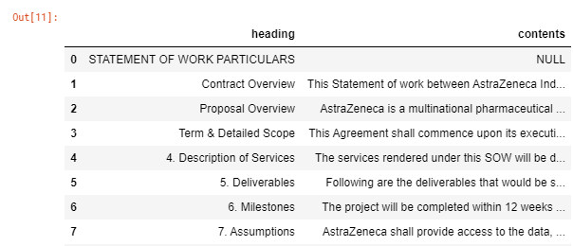
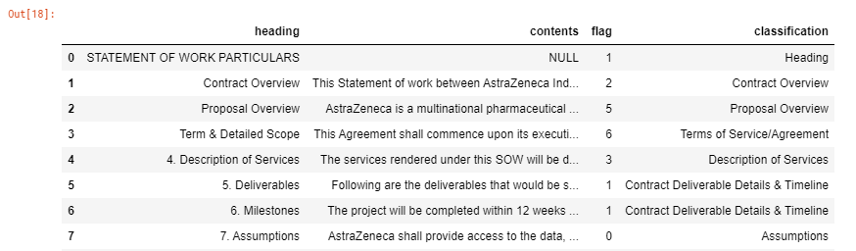
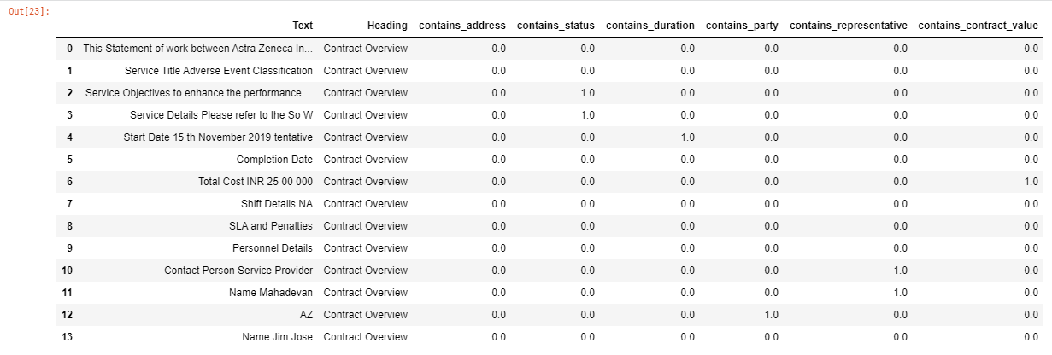
Sample Outputs
Contract Segmentation
Topics Classification
Entity Detector

Slide 10
Next Steps
Named Entity Recognition Module: Pull the relevant entities from specifically identified parts of the document
Contracts Database: Output will be processed into a structured format that can be stored in a suitable database.
Contract KPI Tracking: Dashboard with KPI to showcase a summary of all contracts managed and potential Actions to take.

Slide 11
Appendix: Matrix of API’s Tried and Tested
API and Packages
Package or API
Usage
Disadvantages
PyMuPDF
Packages
Can be used to Extract Headings and Paragraph
PyPDF2
Packages
Can be used to extract entire text content from PDF
Cant work on scanned documents
Pytessarct
Packages
For OCR, convert the pdf pages to image and extract content
Breaks the document pages into separate image files, so more pages more image files
Google
Vision API
API
Uses GCP API which converts the pages to json and extract the content
Can only work with documents stored in google storage and max of 2000 pages
Amazon ReKognition/Textract
API
Currently working on it
IBM Watson Visual Recognition
API
Yet to be tried
Microsoft Computer Vision API
API
Yet to be tried
Notes:
Pricing for Syndicated Data
ESRI – GIS data, Demographics & Consumer Behavior Data - $2500 for 5 users, 2500 credits. Based on usage, no. of credits and price can increase to up to $10,000

